Slide 1
Object Oriented Development Cycle

Slide 2
Software development
Analysis, design, implementation, testing & refinement to transform users’ need into software solution that satisfies those needs
Object-oriented approach
  more rigorous process to do things right
  more time spent on gathering requirements, developing requirements model & analysis model, then turn into design model
  need not see code until after 25% development time

Slide 3
Software development process
Process to change, refine, transform & add to existing product
transformation 1(analysis) - translates user’s need into system’s requirements & responsibilities
  how they use system can give insight into requirements, eg: analyzing payroll - capacity must be included in requirements

Slide 4
Software development process contd…
transformation 2 (design) - begins with problem statement, ends with detailed design that can be transformed into operational system
  bulk of development activity, include definition on how to build software, its development, its testing, design description + prg + testing material

Slide 5
Software development process contd…
transformation 3 (implementation) - refines detailed design into system deployment that will satisfy users’ needs
  takes account of equipment, procedures, resources, people, etc - how to embed software product within its operational environment, eg: new compensation method prg needs new form, gives new report.

Slide 6
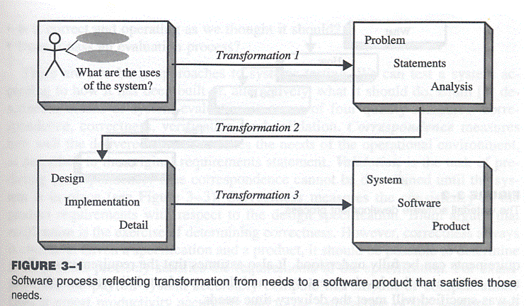
Software process – transforming needs to software product

Slide 7
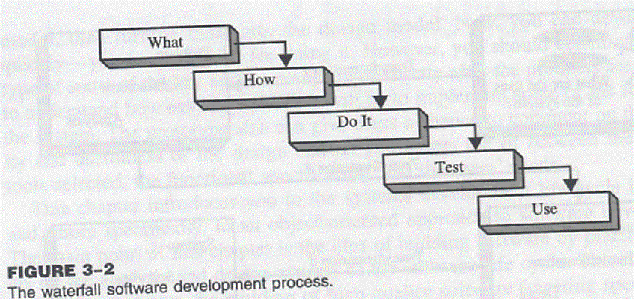
Waterfall Model
– from ‘what’ to ‘use’

Slide 8
Why waterfall model fails
When there is uncertainity regarding what’s required or how it can be built
Assumes requirements are known before design begins
  sometimes needs experience with product before requirements can be fully understood
Assumes requirements remain static over development cycle
  product delivered meets delivery-time needs
Assumes sufficient design knowledge to build product
  best for well-understood product
  inable to cater software special properties or partially understood issues
  doesn’t emphasize or encourage software reuse
Problem if environment changes
  request changes in programs

Slide 9
Building high quality software
Goal is user satisfaction
  how do we determine system is ready for delivery
  is it now an operational system that satisfies users’needs
  is it correct and operating as we thought it should ?
  Does it pass an evaluation process ?

Slide 10
Object-oriented approach: A use-case driven approach
Object-oriented software development life cycle consists of
  Object-oriented analysis
  Object-oriented design
  Object-oriented implementation
Use-case model can be employed throughout most activities of software development
  designs traceable across requirements, analysis, design, implementation & testing can be produced
  all design decisions can be traced back directly to user requirements
  usage scenarios can be test scenarios

Slide 11
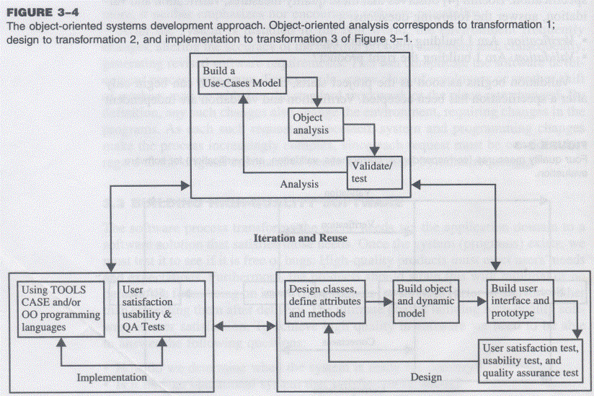
Object-oriented Systems Development Approach

Slide 12
Object-oriented software development
Activities
    Object-oriented analysis - use case driven
    Object-oriented design
    Prototyping
    Component-based development
    Incremental testing
Encourages
  viewing of system as a system of cooperative objects
  incremental development

Slide 13
Object-oriented analysis - use-case driven
Use Case, is a name for a scenario to describe the user–computer system interaction.
Determine system requirements, identify classes & their relationship to other classes in domain
To understand system requirements
  need to identify the users or actors
    who are the actors ? How do they use system ?
  Scenarios can help (in traditional development, it is treated informally, not fully documented)
    Jacobson introduces concept of use case - scenario to describe user-computer system interaction

Slide 14
Use case
Typical interaction between user & system that captures users’ goal & needs
  In simple usage, capture use case by talking to typical users, discussing various things they might want to do with system
  can be used to examine who does what in interactions among objects, what role they play, intersection among objects’ role to achieve given goal is called collaboration
  several scenarios (usual & unusual behaviour, exceptions) needed to understand all aspects of collaboration & all potential actions
use cased modeling
  expressing high level processes & interactions with customers in a scenario & analyzing it
  gives system uses, system responsibilities
developing use case is iterative
  when use case model better understood & developed, start identifying classes & create their relationship

Slide 15
Identifying objects
What are physical objects in system ?
  Individuals, organizations, machines, units of information, pictures, whatever makes up application/ make sense in context of real world
objects help establish workable system
  work iteratively between use-case & object models
  incentive payroll - employee, supervisor, office administrator, paycheck, product made, process used to make product
Documentation
  80-20 rule
  80% work can be done with 20% documentation
  20% easily accessible, 80% available to few who needs to know
  modeling & documentation inseparatable
    good modeling implies good documentation

Slide 16
Object-oriented Design
Goal : to design classes identified during analysis phase & user interface
Identify additional objects & classes that support implementation of requirements
  Eg. add objects for user interface to system (data entry windows, browse windows)
Can be intertwined with analysis phase
  Highly incremental, eg. can start with object-oriented analysis, model it, create object-oriented design, then do some more of each again & again, gradually refining & completing models of system
  Activities & focus of oo analysis & oo design are intertwined, grown not built

Slide 17
Object-oriented Design
First, build object model based on objects & relationship
Then iterate & refine model
  Design & refine classes
  Design & refine attributes
  Design & refine methods
  Design & refine structures
  Design & refine associations

Slide 18
Guidelines in Object-oriented Design
Reuse rather than build new classes
  Know existing classes
Design large number of simple classes rather than small number of complex classes
Design methods
Critique what has been proposed
  Go back & refine classes

Slide 19
Prototyping
Prototype – version of software product developed in early stages of product’s life cycle for specific, experimental purposes
  Enables us to fully understand how easy/difficult it will be to implement some features of system
  Gives users chance to comment on usability & usefulness of user interface design
  Can assess fit between software tools selected, functional specification & user needs
  Can further define use cases, makes use case modeling easier
    prototype that satisfies user + documentation -> define basic courses of action for use cases covered by prototype
Important to construct prototype of key system components shortly after products are selected
  Pictures worth a thousand words
  Build prototype with use-case modeling to design systems that users like & need

Slide 20
Prototyping: old & new
Before: prototype thrown away when industrial strength version developed
New trend: (eg. rapid application development) prototype refined into final product
  Prototype used as means to test & refine user interface & increase usability of system
  As underlying prototype design becomes more consistent with application requirements, more detail can be added to application
  Test, evaluate & build further till all components work properly

Slide 21
Developing prototypes
Typical time from few days to few weeks
Should be done parallel with preparation of functional spec
  Can result in modification of spec (some problems/features only obvious after prototype built)
Should involve representation from all user groups that will be affected by project
  To ascertain all that the general structure of the prototype meets requirements established for overall design
Purpose of review
  Demo that prototype has been developed according to spec & that final spec is appropriate
  Collect info about errors & problems in systems, eg user interface problems
  Give management & everyone connected with project glimpse of what technology can provide
Evaluation easier if supporting data readily available
Testing considerations must be incorporated in design & implementation of systems

Slide 22
Implementation: Component-based development
No more custom development, now assemble from prefabricated components
  No more cars, computers, etc custom designed & built for each customer
  Can produce large markets, low cost, high quality products
  Cost & time reduced by building from pre-built, ready-tested components
  Value & differentiation gained by rapid customization to targeted customers

Slide 23
Component-based development
Industrialized approach to system development, move form custom development to assembly of pre-built, pre-tested, reusable software components that operate with each other
  Application development improved significantly if applications assembled quickly from prefabricated software components
  Increasingly large collection of interpretable software components could be made available to developers in both general & specialist catalogs
Components themselves can be constructed from other components, down to prebuilt components/old-fashioned code written in prg languages like C
Visual tools/actual code can be used to glue together components
  Visual glue – Digitalk’s Smalltalk PARTS, IBM VisualAge
Less development effort, faster, increase flexibility

Slide 24
Rapid Application Development
Set of tools & techniques to build application faster than typically possible with traditional methods
Often used with software prototyping
Iterational development
  Implement design & user requirements incrementally with tools like Delphi, VisualAge, Visual Basic, or PowerBuilder
  Begins when design completed
    Do we actually understood problem (analysis) ?
    Does the system do what it is supposed to do (design) ?
    Make improvement in each iteration

Slide 25
Incremental testing
Software development and all of its activities including testing are an iterative process.
Waiting until after development waste money & time
Turning over applications to quality assurance group not helping since they are not included in initial plan

Slide 26
Reusability
Major benefit of Object-oriented approach
For objects to be reusable, much effort must be spent of designing it
  Design reusability
Effectively evaluate existing software components
  Has my problem been solved ?
  Has my problem been partially solved ?
  What has been done before to solve problem similar to this one ?
Need
  detailed summary info about existing software components
  Some kind of search mechanism
    Define candidate object simply
    Generate broadly/narrowly defined query

Slide 27
Reuse Strategy
Information hiding
Conformance to naming standards
Creation & administration of an object repository
Encouragement by strategic management of reuse as opposed to constant redevelopment
Establish target for % of object in project to be reuse

Slide 28
Overview of Unified Modeling Language: UML fundamentals & Notations

Slide 29
UML-Unified Modeling Language
UML → “Unified Modeling Language”
Language: express idea, not a methodology
Modeling: Describing a software system at a high level of abstraction
Unified: UML has become a world standard
Object Management Group (OMG): www.omg.org

Slide 30
UML-Unified Modeling Language contd…
visual language for specifying, constructing & documenting the artifacts of system
de facto standard diagramming notation or presenting pictures related to software
Object Oriented Fundamentals

Slide 31
Ways to apply UML
There are three ways people apply UML.
They are:
UML as sketch
  Informal and incomplete diagrams created to explore difficult parts of the problem or solution space, exploiting the power of visual language

Slide 32
Contd..
2. UML as blueprint
  Relatively detailed design diagrams used either for reverse engineering to visualize and better understanding existing code in UML diagrams or for code generation (forward engineering)
3. UML as programming language
  Complete executable specification of a software system in UML
  Executable code will be automatically generated
Object Oriented Fundamentals

Slide 33
Contd…
Agile Modeling
  Emphasizes UML as sketch; this is a common way to apply the UML, often with a high return on investment of time
  UML tools are/can be useful but still agile modeling approach to applying UML is encouraged

Slide 34
Three perspective to apply UML
UML describes raw diagram types, such as class diagrams & sequence diagrams & same UML can be used to draw pictures of concepts of software classes in Java.
i.e. the same notation is used for three perspectives & types of models.

Slide 35
Contd…
Conceptual perspective- the diagrams are interpreted as describing things in a situation of the real world or domain of interest.
Specification(software) perspective- the diagrams (using the same notation as in the conceptual perspective) describe software abstraction or components with specification and interfaces, but no commitment to particular implementation( for example, not specially a class in C# or Java)
Implementation (software) perspective- the diagram describe software implementations in a particular language (such as Java).

Slide 36
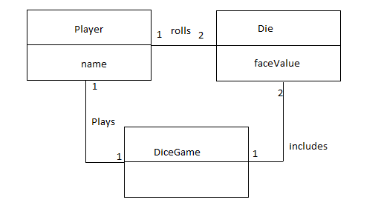
Fig-Conceptual Perspective

Slide 37
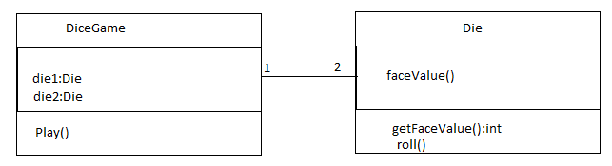
Fig – Specification Perspective

Slide 38
UML Diagrams
UML can be used to construct nine different diagrams to capture different views of the system

Slide 39
UML Diagrams
The nine different UML diagrams are:
Class Diagram
Object Diagram
Use Case Diagram
Sequence Diagram
Collaboration Diagram
Statechart Diagram
Activity Diagram
Component Diagram
Deployment Diagram

Slide 40
UML Views
The different views are
  Structural
  Behavioral
  Implementation
  Environmental as shown in the figure below

Slide 41
Contd...
Structural
View
Implementation
View
Class Diagrams
Object Diagrams
Component Diagrams
User View
Use Case
Diagrams
Sequence Diagrams
Collaboration Diagrams
Statechart Diagrams
Activity Diagrams
Deployment Diagrams
Behavioral
View
Environment
View

Slide 42
More on diagrams….
Class Diagram - the most common diagram found in OOAD, shows a set of classes, interfaces, collaborations and their relationships. Models the static view of the system.
Object Diagram - a snapshot of a class diagram; models the instances of things contained in a class diagram.
Use Case Diagram - shows a set of “Use Cases” (sets of functionality performed by the system), the “actors” (typically, people/systems that interact with this system[problem-domain]) and their relationships. Models WHAT the system is expected to do.

Slide 43
More on diagrams….
Sequence Diagram - models the flow of control by time-ordering; depicts the interaction between various objects by of messages passed, with a temporal dimension to it.
Collaboration Diagram - models the interaction between objects, without the temporal dimension; merely depicts the messages passed between objects.
Statechart Diagram - shows the different state machines and the events that leads to each of these state machines. Statechart diagrams show the flow of control from state to state.

Slide 44
More on diagrams….
Activity Diagram - shows the flow from activity to activity; an “activity” is an ongoing non-atomic execution within a state machine.
Component Diagram - shows the physical packaging of software in terms of components and the dependencies between them.
Deployment Diagram - shows the configuration of the processing nodes at run-time and the components that live on them.

Slide 45
UML Class Diagrams
Class diagram describes
  Types of objects in the system
  Static relationships among them
Two principal kinds of static relationships
  Associations between classes
  Subtype relationships between classes
Class descriptions show
  Attributes
  Operations
Class diagrams can also show constraints on associations

Slide 46
Example Class Diagram
Order
Customer
dateReceived
isPrepaid
number: String
price: Money
1..*
1
name
address
creditRating():String
dispatch()
close()
Constraint
for order class
indicates
generalization
1
Corporate
Customer
Personal
Customer
{ if Order.customer.creditRating() = “poor”
then Order.isPrepaid = true }
creditCardNumber
contactName
creditRating
creditLimit
Ordered
Product
1..*
remind()
billForMonth(Int)
Product Order
{creditRating()=“poor”}
quantity: Int
price: Money
isSatisfied: Bool
1..*
1
1..*
indicates that credit
rating is always
set to poor for a
Personal Customer
Product
Sales
Rep
0..1
Employee

Slide 47
Sequence Diagrams
A sequence diagram shows a particular sequence of messages exchanged between a number of objects
Sequence diagrams also show behavior by showing the ordering of message exchange
A sequence diagram shows some particular communication sequences in some run of the system
  it is not characterizing all possible runs

Slide 48
A First Look at Sequence Diagrams
Illustrates how objects interacts with each other.
Emphasizes time ordering of messages.
Can model simple sequential flow, branching, iteration, recursion and concurrency.
Sequence Diagrams

Slide 49
A Sequence Diagram
member:
LibraryMember
book:Book
:Book
Copy
borrow(book)
ok = mayBorrow()
[ok] borrow(member)
setTaken(member)
Sequence Diagrams

Slide 50
A Sequence Diagram
X-Axis (objects)
member:
LibraryMember
book:Book
:Book
Copy
borrow(book)
Object
Life Line
ok = mayBorrow()
Y-Axis (time)
message
Activation box
[ok] borrow(member)
setTaken(member)
condition
Sequence Diagrams

Slide 51
Object
Object naming:
  syntax: [instanceName][:className]
  Name classes consistently with your class diagram (same classes).
  Include instance names when objects are referred to in messages or when several objects of the same type exist in the diagram.
The Life-Line represents the object’s life during the interaction
myBirthdy
:Date
Sequence Diagrams

Slide 52
Messages
An interaction between two objects is performed as a message sent from one object to another
If object obj₁ sends a message to another object obj₂ some link must exist between those two objects
Sequence Diagrams

Slide 53
Messages (Cont.)
A message is represented by an arrow between the life lines of two objects.
  Self calls are also allowed
  The time required by the receiver object to process the message is denoted by an activation-box.
A message is labeled at minimum with the message name.
  Arguments and control information (conditions, iteration) may be included.
Sequence Diagrams

Slide 54
Return Values
Optionally indicated using a dashed arrow with a label indicating the return value.
  Don’t model a return value when it is obvious what is being returned, e.g. getTotal()
  Model a return value only when you need to refer to it elsewhere, e.g. as a parameter passed in another message.
  Prefer modeling return values as part of a method invocation, e.g. ok = isValid()
Sequence Diagrams

Slide 55
Synchronous Messages
Nested flow of control, typically implemented as an operation call.
  The routine that handles the message is completed before the caller resumes execution.
:A
:B
doYouUnderstand()
return (optional)
Caller Blocked
yes
Sequence Diagrams

Slide 56
Object Creation
An object may create another object via a <<create>> message.
Preferred
:A
:B
:A
<<create>>
<<create>>
:B
Constructor
Sequence Diagrams

Slide 57
Object Destruction
An object may destroy another object via a <<destroy>> message.
  An object may destroy itself.
  Avoid modeling object destruction unless memory management is critical.
:A
:B
<<destroy>>
Sequence Diagrams

Slide 58
Control information
Condition
  syntax: ‘[‘ expression ’]’ message-label
  The message is sent only if the condition is true
  example:
Iteration
  syntax: * [ ‘[‘ expression ‘]’ ] message-label
  The message is sent many times to possibly multiple receiver objects.
[ok] borrow(member)
Sequence Diagrams

Slide 59
Control Information (Cont.)
Iteration examples:
:CompoundShape
:Shape
:Driver
:Bus
draw()
*draw()
*[until full] insert()
The syntax of expressions is not a standard
Sequence Diagrams

Slide 60
Control Information (Cont.)
The control mechanisms of sequence diagrams suffice only for modeling simple alternatives.
  Consider drawing several diagrams for modeling complex scenarios.
  Don’t use sequence diagrams for detailed modeling of algorithms (this is better done using activity diagrams, pseudo-code or state-charts).
Sequence Diagrams

Slide 61
Example Sequence Diagram
:OrderEntryWindow
:Order
:ProductOrder
:StockItem
prepare()
*prepare()
check()
[check=“true”]
remove()
needsToReorder()
[needsToReorder=“true”]
<<create>>
:ReorderItem
[check=“true”]
<<create>>
:DeliveryItem

Slide 62
Collaboration (Communication) Diagrams
Collaboration diagrams show a particular sequence of messages exchanged between a number of objects
  this is what sequence diagrams do too!
Use sequence diagrams to model flows of control by time ordering
  sequence diagrams can be better for demonstrating the ordering of the messages
  sequence diagrams are not suitable for complex iteration and branching
Use collaboration diagrams to model flows of control by organization
  collaboration diagrams are good at showing the static connections among the objects while demonstrating a particular sequence of messages at the same time

Slide 63
Corresponding Collaboration Diagram
Sequence numbers are used
to show the time ordering among
the messages
object
:OrderEntryWindow
1:prepare()
message
link
sequence number
:Order
1.1:*prepare()
1.1.2.1:needsToReorder()
:ProductOrder
:StockItem
1.1.1:check()
1.1.2:[check==true]remove()
1.1.2.2:new
1.1.3:[check==true]new
:DeliveryItem
:ReorderItem

Slide 64
State Diagrams
State diagrams are used to show possible states a single object can get into
  shows states of an object
How object changes state in response to events
  shows transitions between states

Slide 65
State Diagrams
Hierarchical grouping of states
  composite states are formed by grouping other states
  A composite state has a set of sub-states
Concurrent composite states can be used to express concurrency
  When the system is in a concurrent composite state, it is in all of its substates at the same time
  When the system is in a normal (non-concurrrent) composite state, it is in only one of its substates
  If a state has no substates it is an atomic state
Synchronization and communication between different parts of the system is achieved using events

Slide 66
State Diagrams: Superstates
Active is a superstate
with substates Checking,
Waiting and Dispatching
/ getFirstItem
Active
getNextItem
[not all items checked]
Checking
[all items checked and
all items available]
Dispatching
do/checkItem
do/initiate
Delivery
itemReceived
[all items available]
[all items checked and
some items not in stock]
itemsReceived
[some items not in stock]
Waiting
cancelled
Cancelled
Delivered

Slide 67
Activity Diagrams
Activity diagrams show the flow among activities and actions associated with a given object using:
  activity and actions
  transitions
  branches
  merges
  forks
  joins
Activity diagrams are basically an advanced version of flowcharts

Slide 68
Finance
Order
Processing
Stock
Manager
Receive Order
ReceiveSupply
*for each
order item
Choose Outstanding Order Items
Authorize Payment
Check Order
Item
vertical lines
are used to separate
“swimlanes”
to show which
activities are handled
by which part of the
system
* for each
chosen
order item
[in stock]
[failed]
Assign to Order
Assign to Order
[succeeded]
Cancel Order
[need to reorder]
Reorder
item
[all outstanding order
items filled]
[stock assigned to all order items
and payment authorized]
Add Remainder
to Stock
Dispatch
Order

